Slide 1
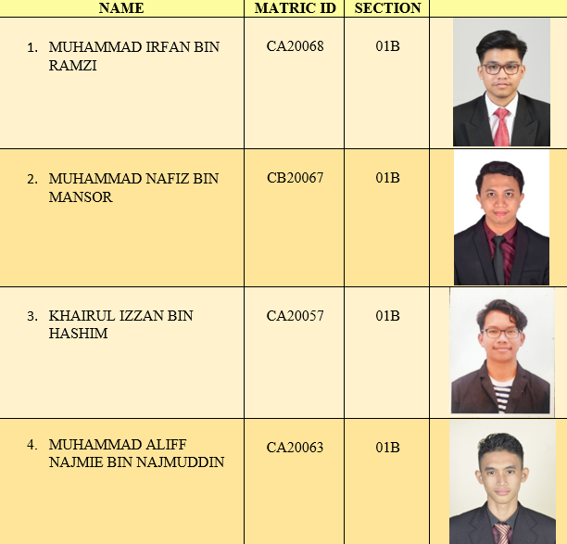
Mini Project Problem Solving BCI1143 Group 1 : E-Wallet

Slide 2
Case Study

Slide 3
Case Study

Slide 4
Problem Analysis Chart (PAC)

Slide 5
Interactive Chart

Slide 6
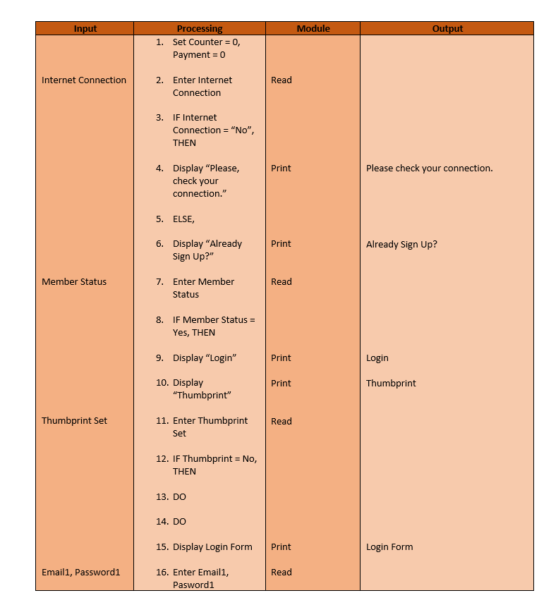
Input-Processing-Output (IPO)

Slide 7
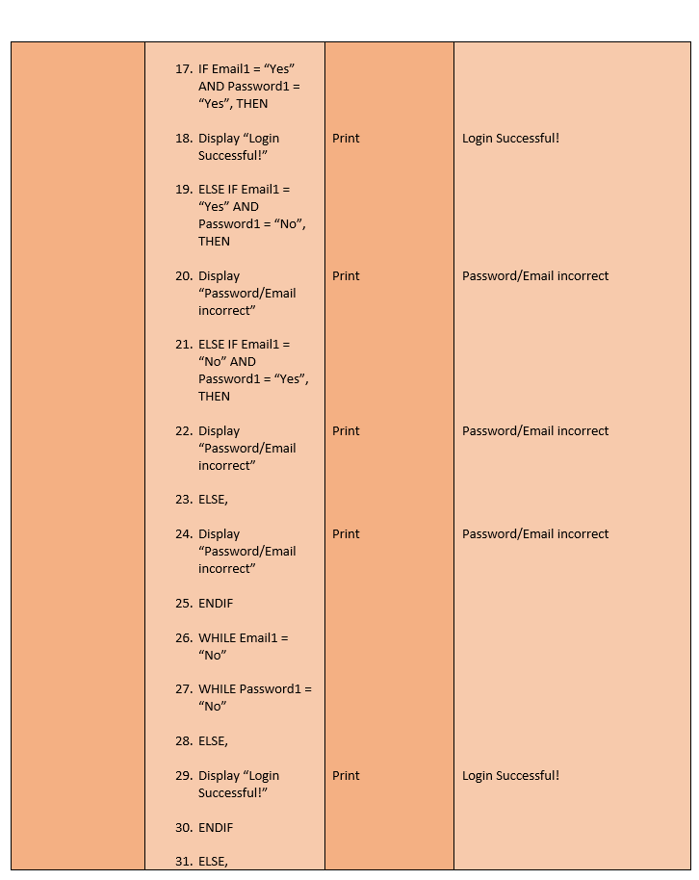
Input-Processing-Output (IPO)

Slide 8
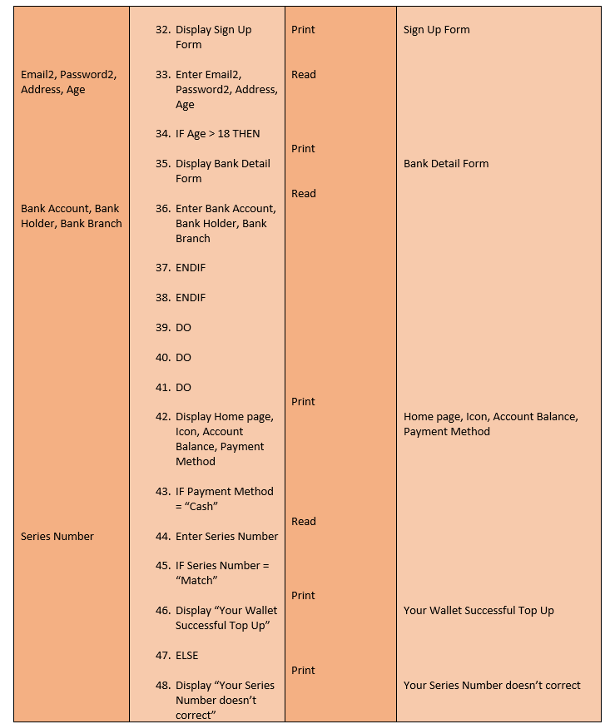
Input-Processing-Output (IPO)

Slide 9
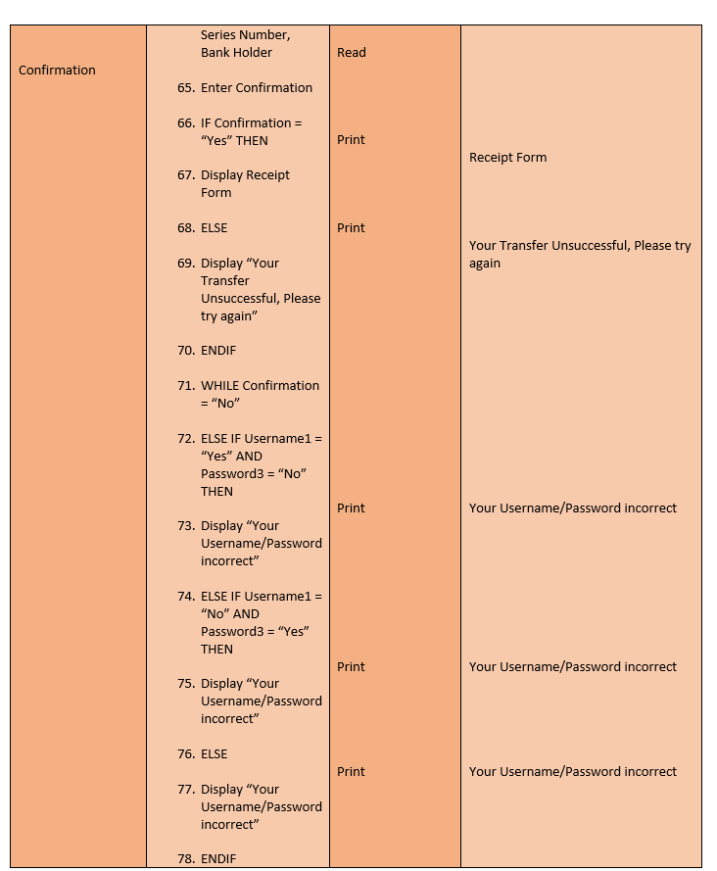
Input-Processing-Output (IPO)

Slide 10
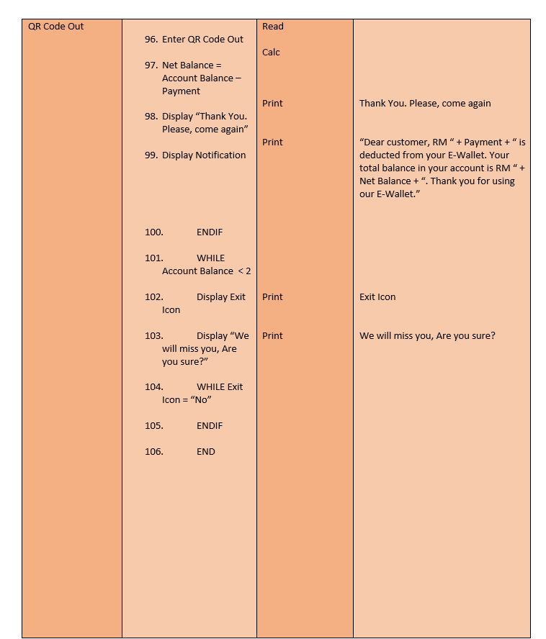
Input-Processing-Output (IPO)

Slide 11
Algorithm – Without Module

Slide 12
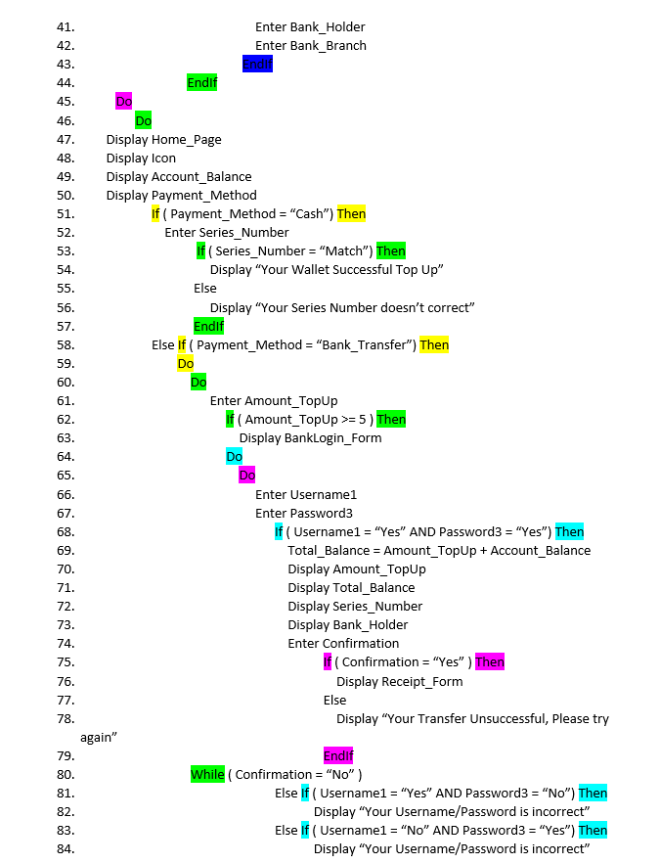
Algorithm – Without Module

Slide 13
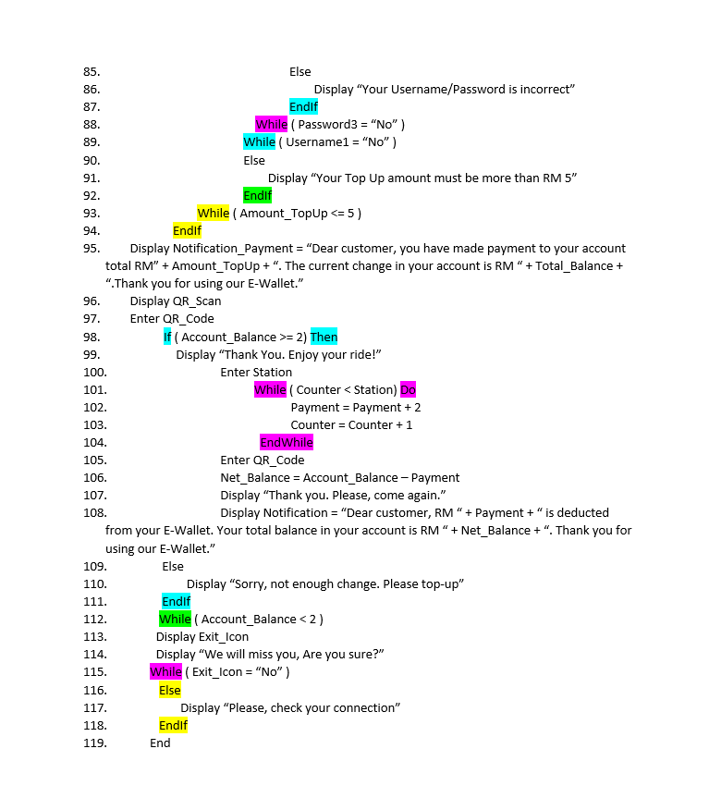
Algorithm – Without Module

Slide 14
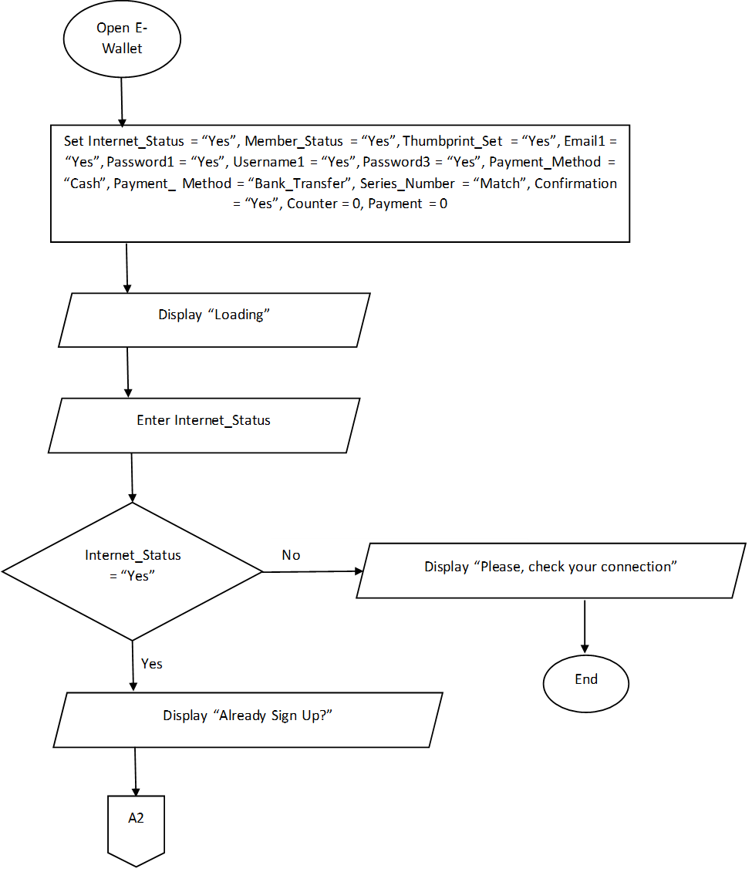
Flowchart – Without Module

Slide 15
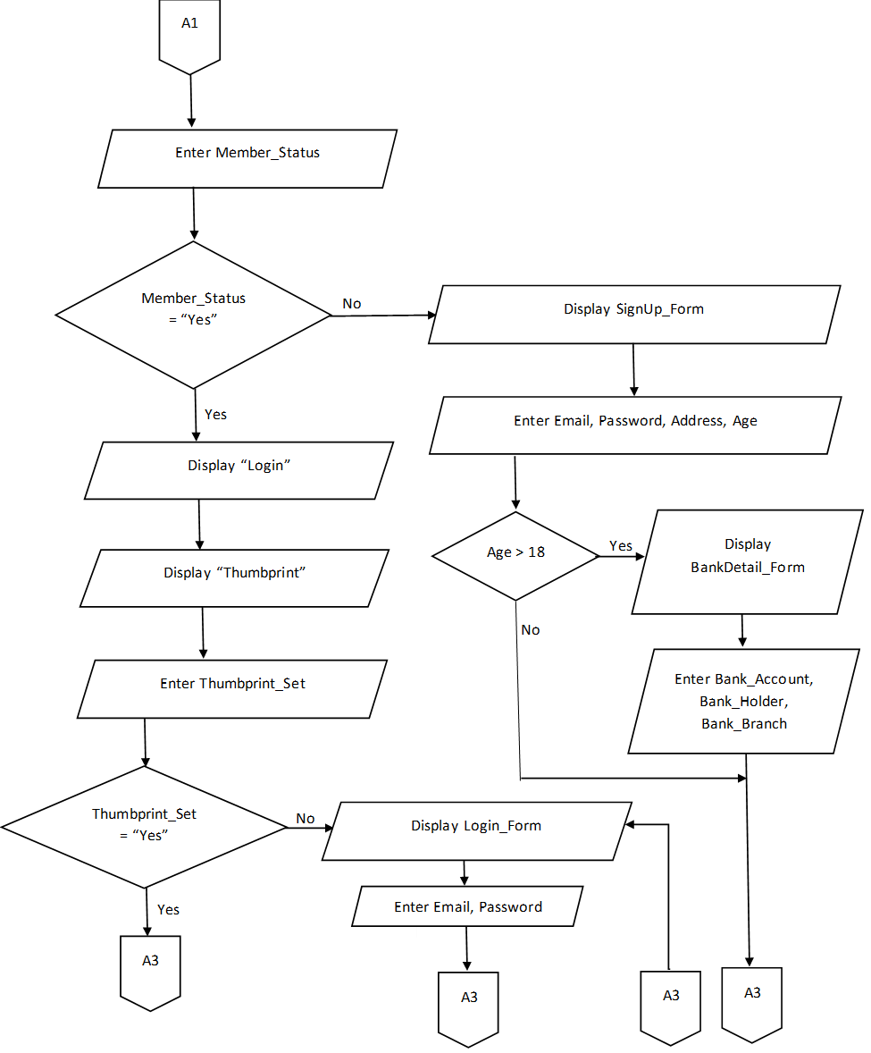
Flowchart – Without Module

Slide 16
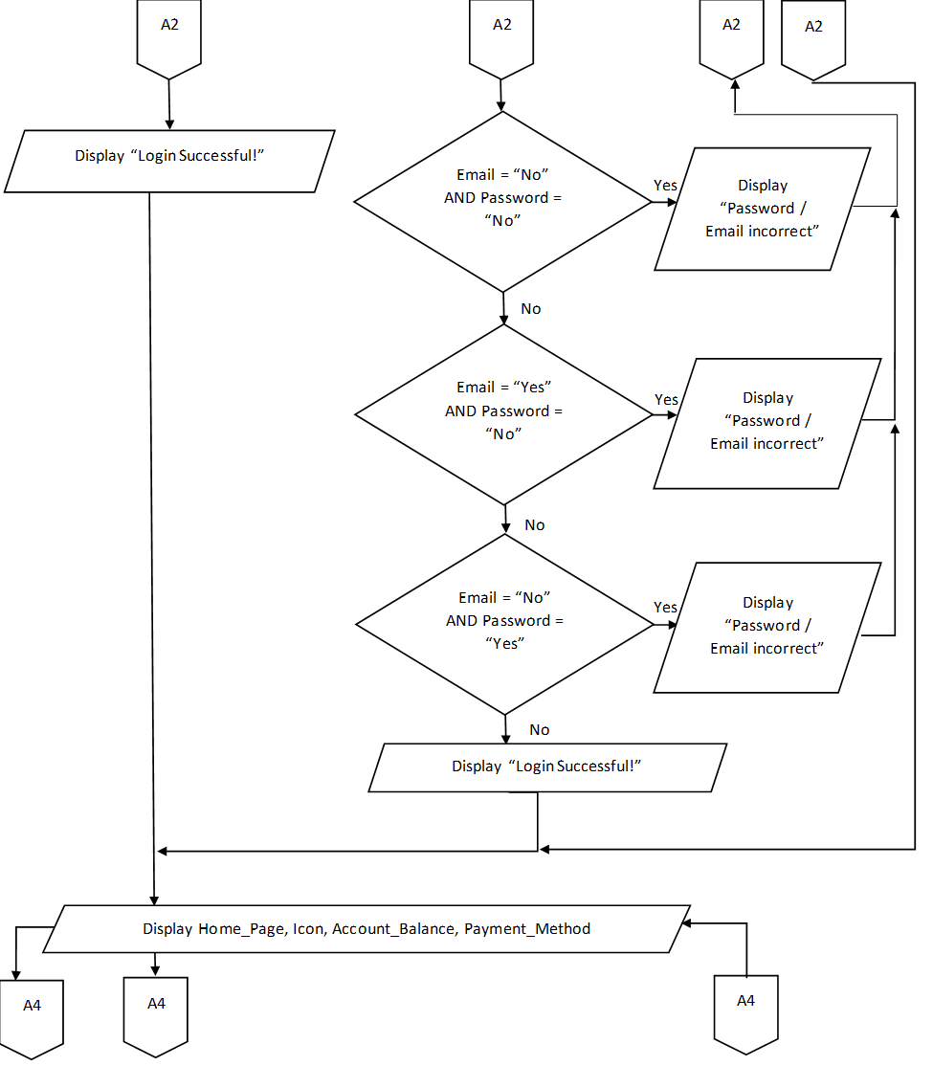
Flowchart – Without Module

Slide 17
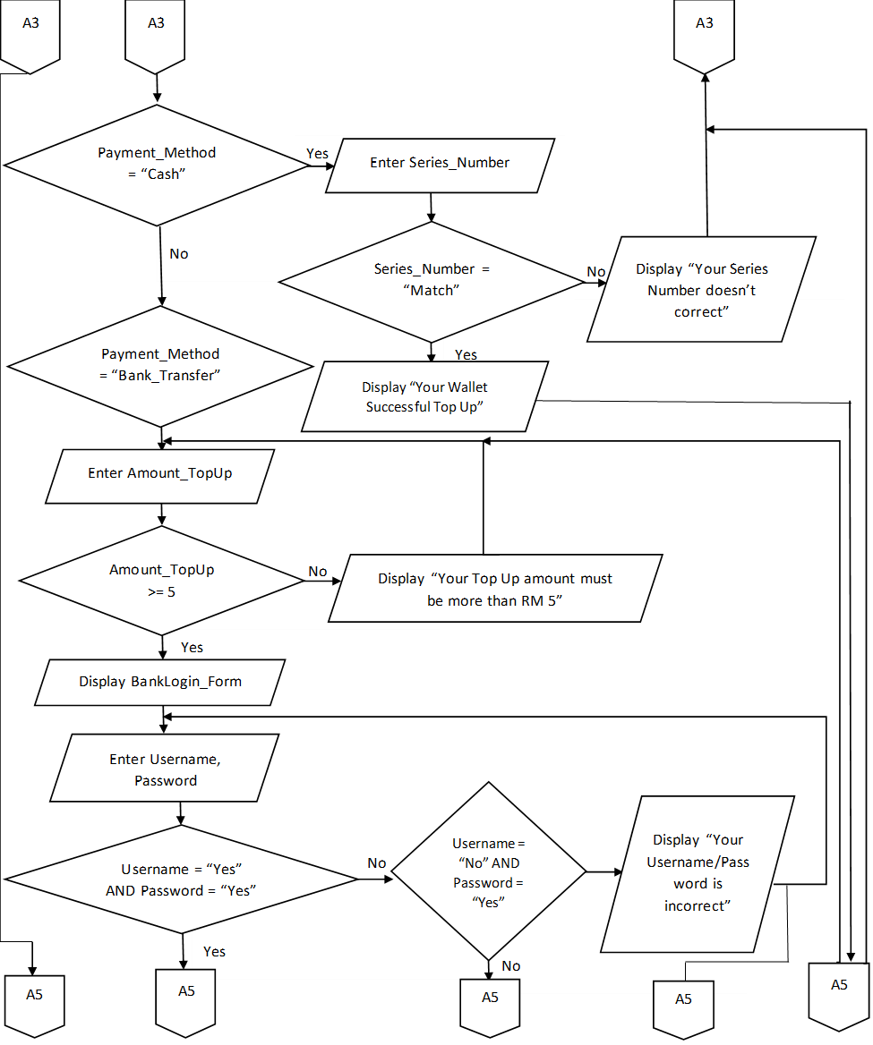
Flowchart – Without Module

Slide 18
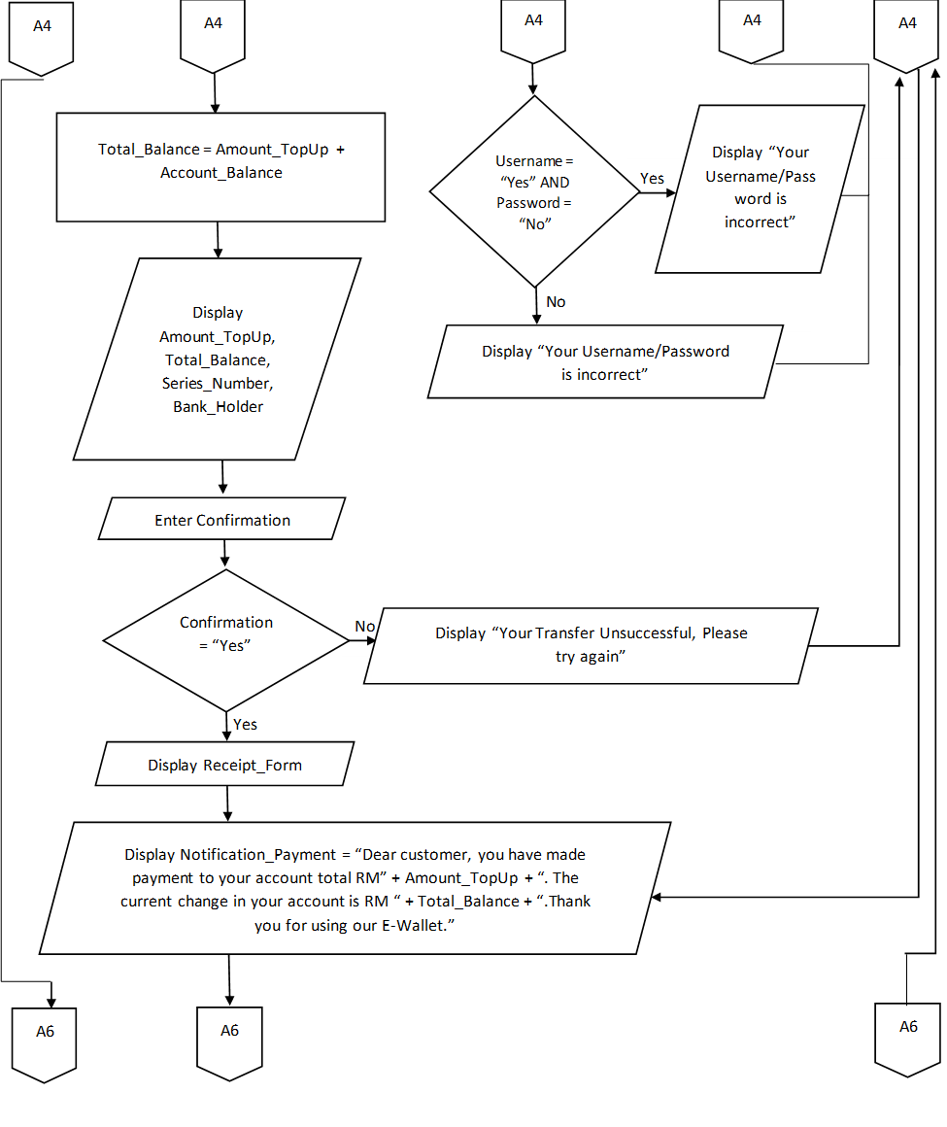
Flowchart – Without Module

Slide 19
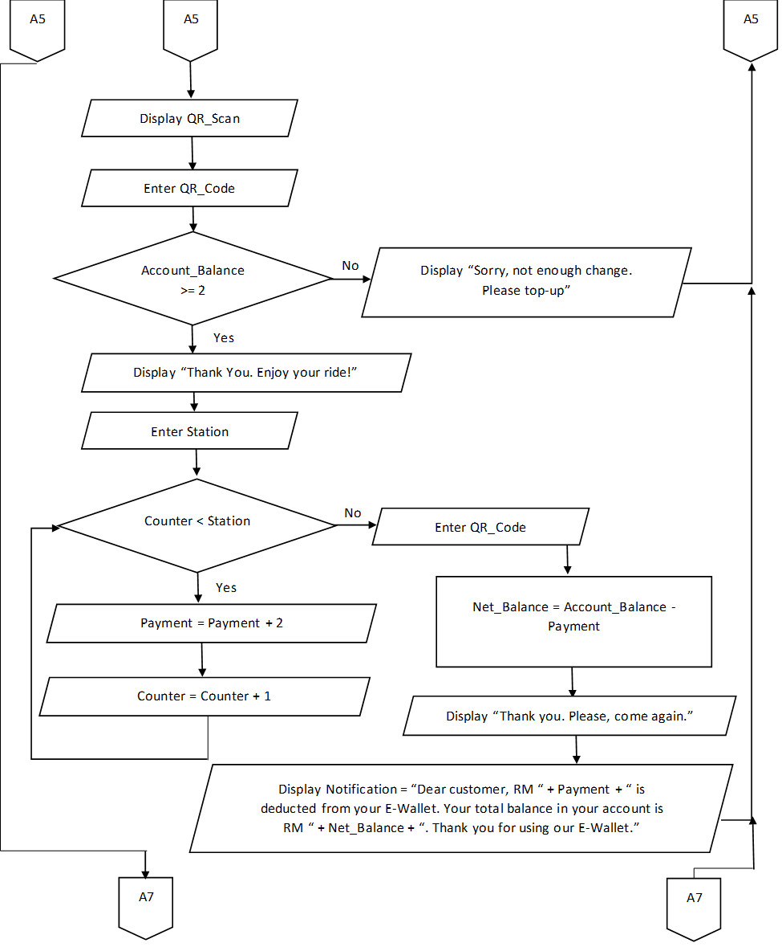
Flowchart – Without Module

Slide 20
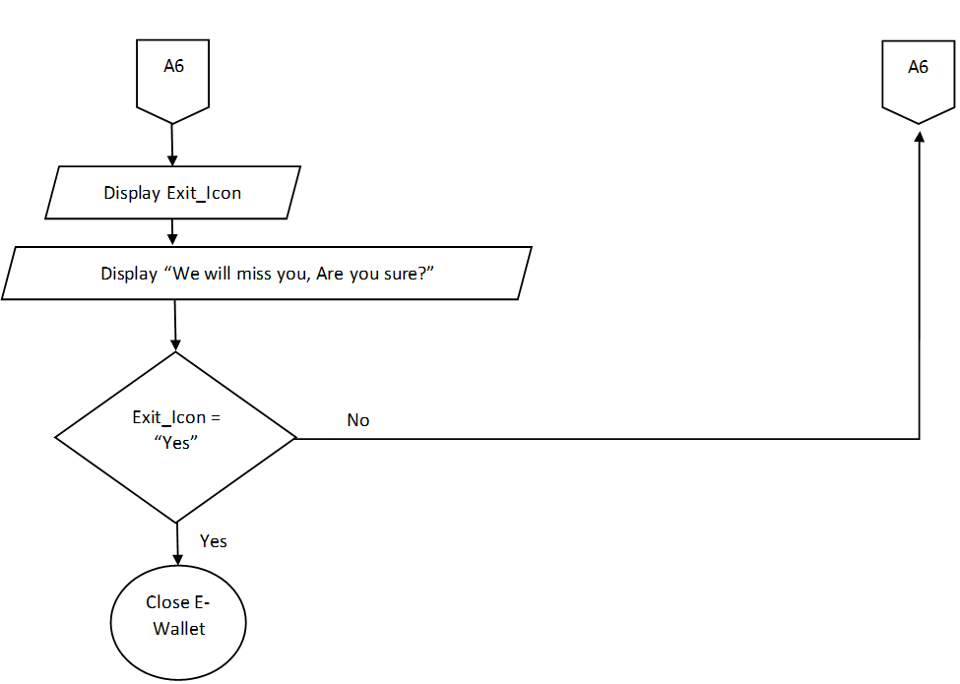
Flowchart – Without Module

Slide 21
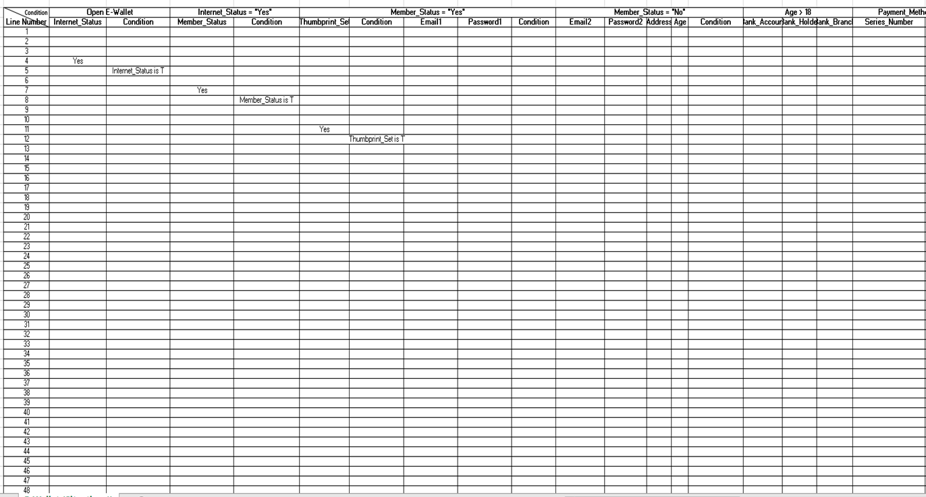
Desk Checking (Line 1-48)

Slide 22
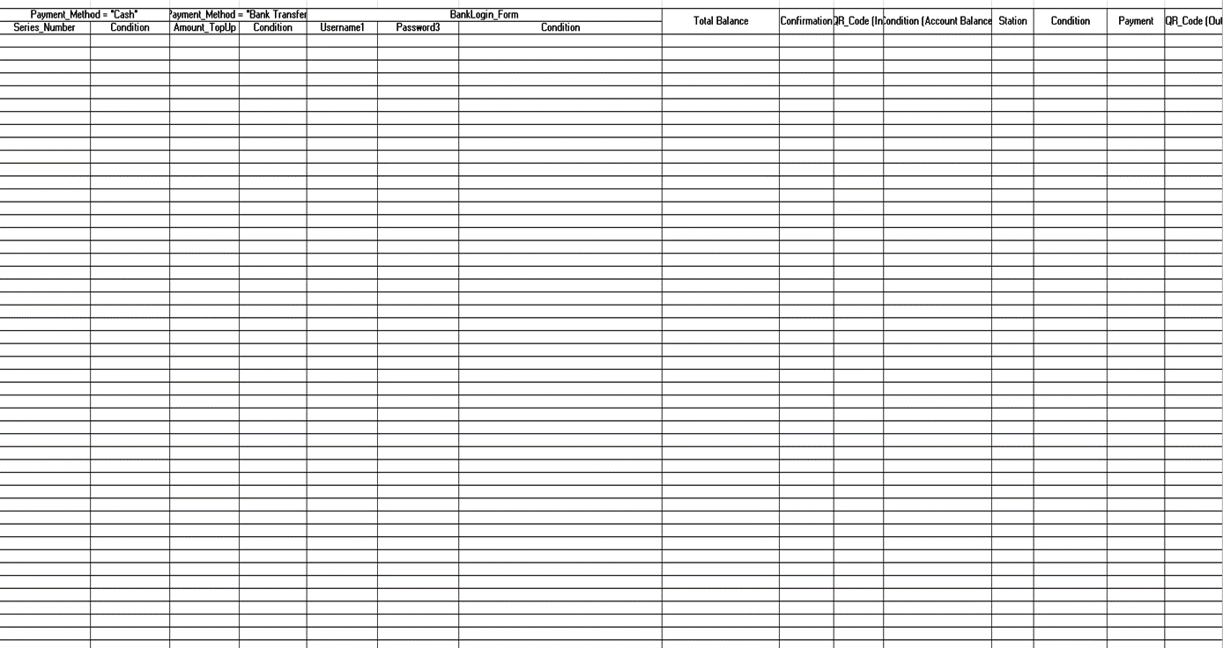
Desk Checking (Line 1-48 cont)

Slide 23
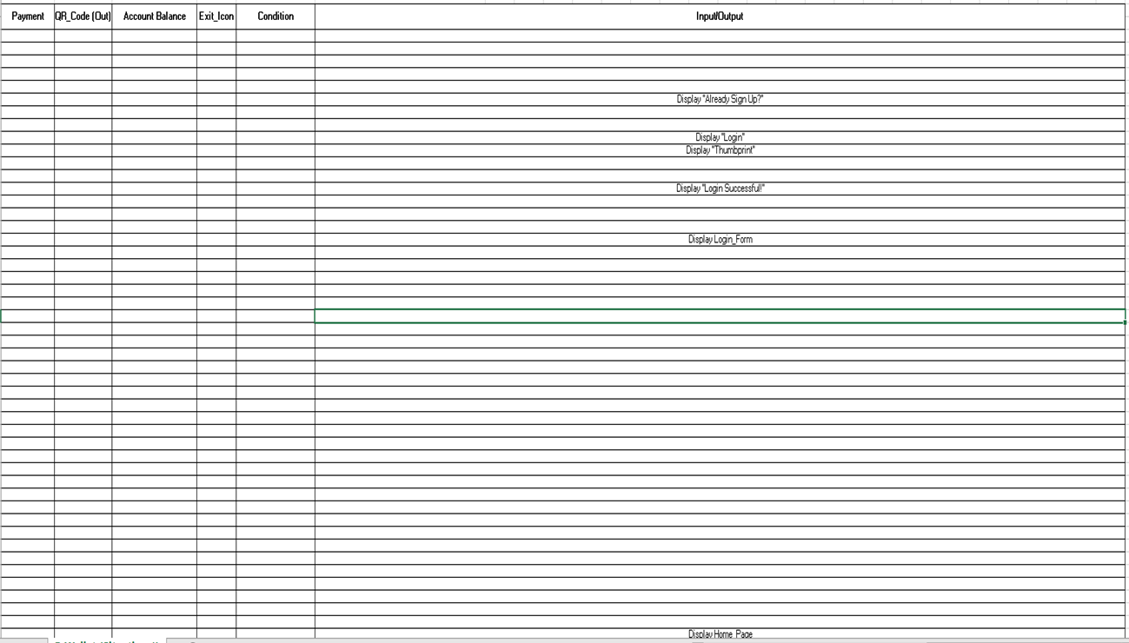
Desk Checking (Line 1-48 cont)

Slide 24

Desk Checking (Line 44-94)

Slide 25
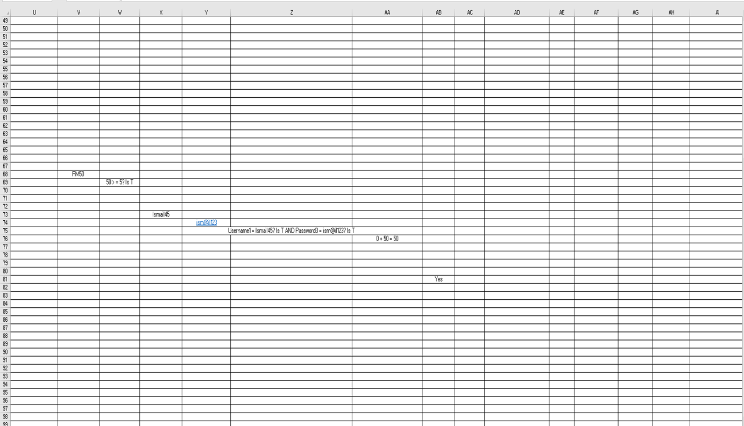
Desk Checking (Line 44-94 cont)

Slide 26
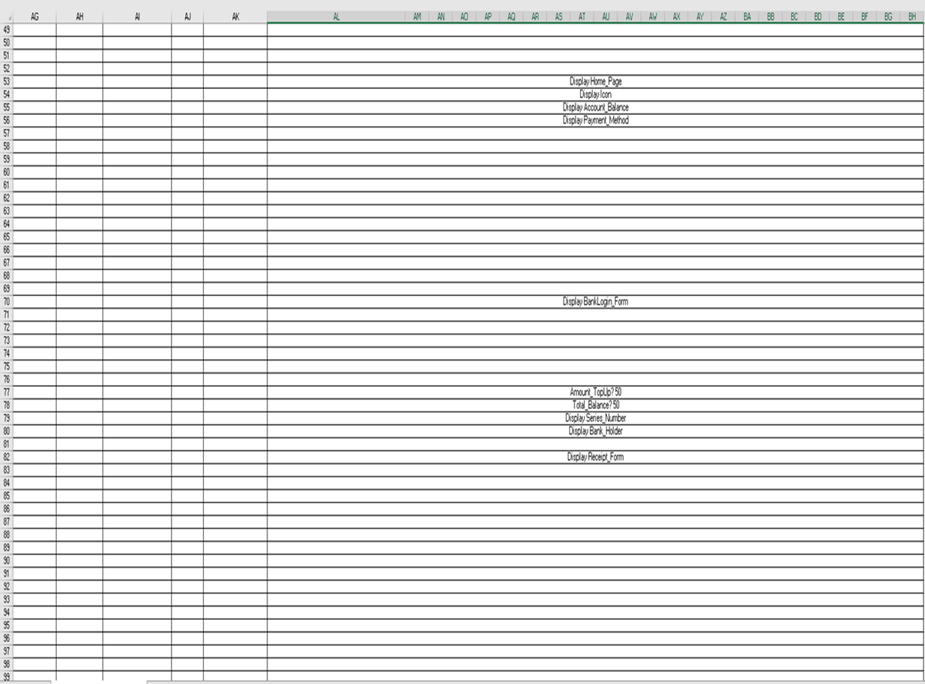
Desk Checking (Line 44-94 cont)

Slide 27
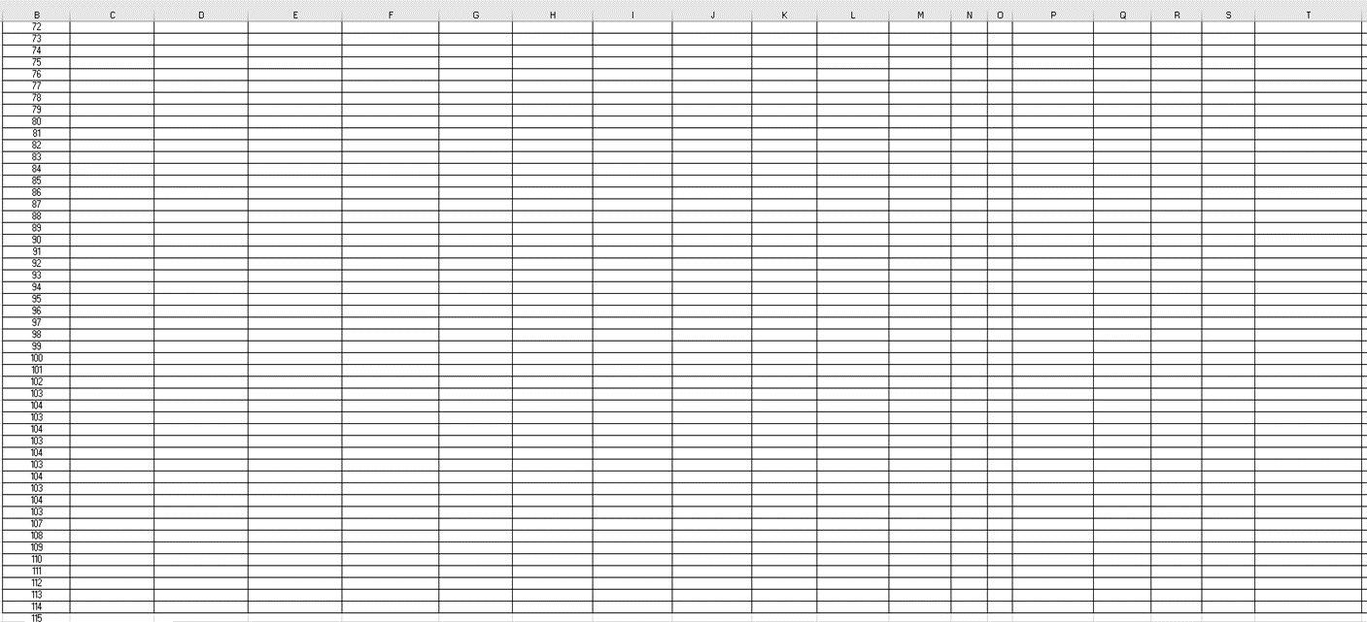
Desk Checking (Line 72-114)

Slide 28
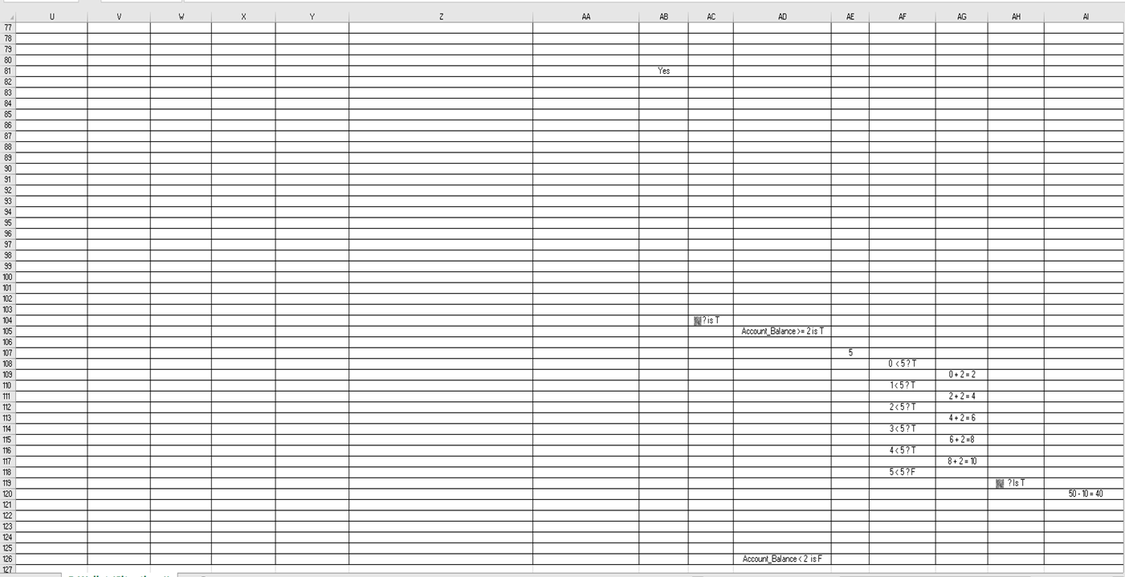
Desk Checking (Line 72-114cont)

Slide 29
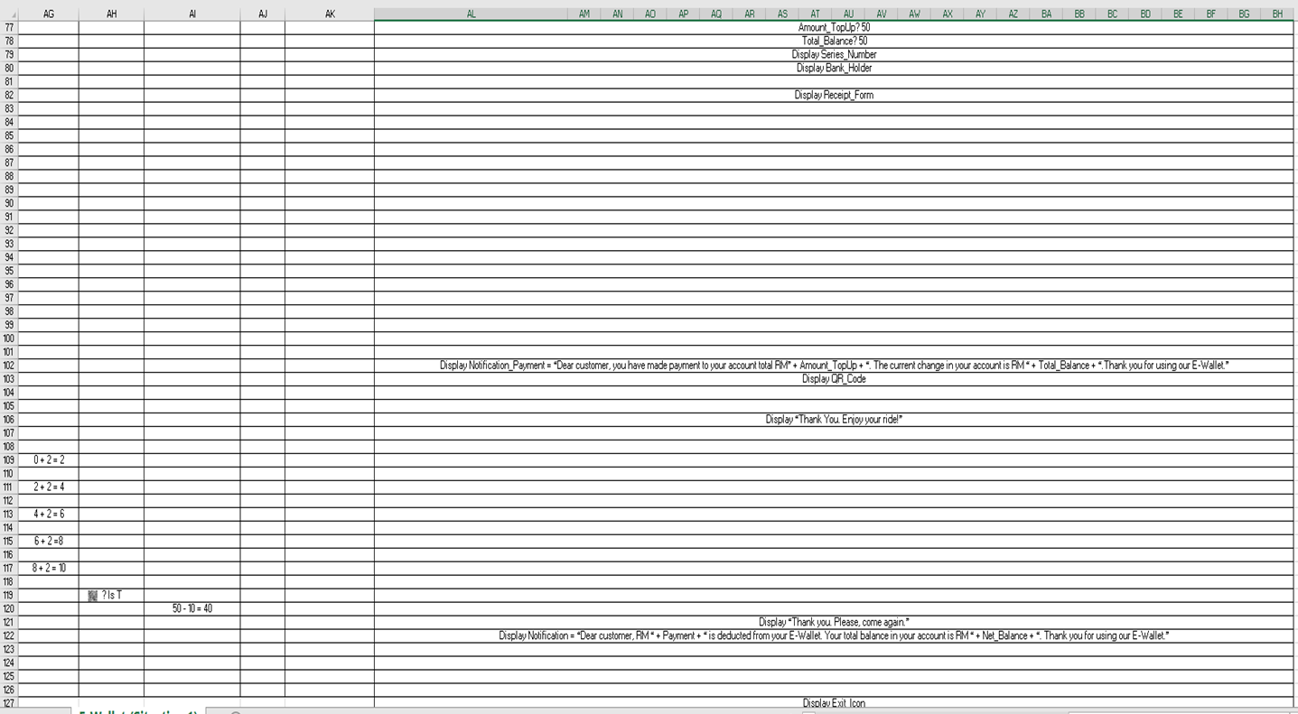
Desk Checking (Line 72-114cont)

Slide 30
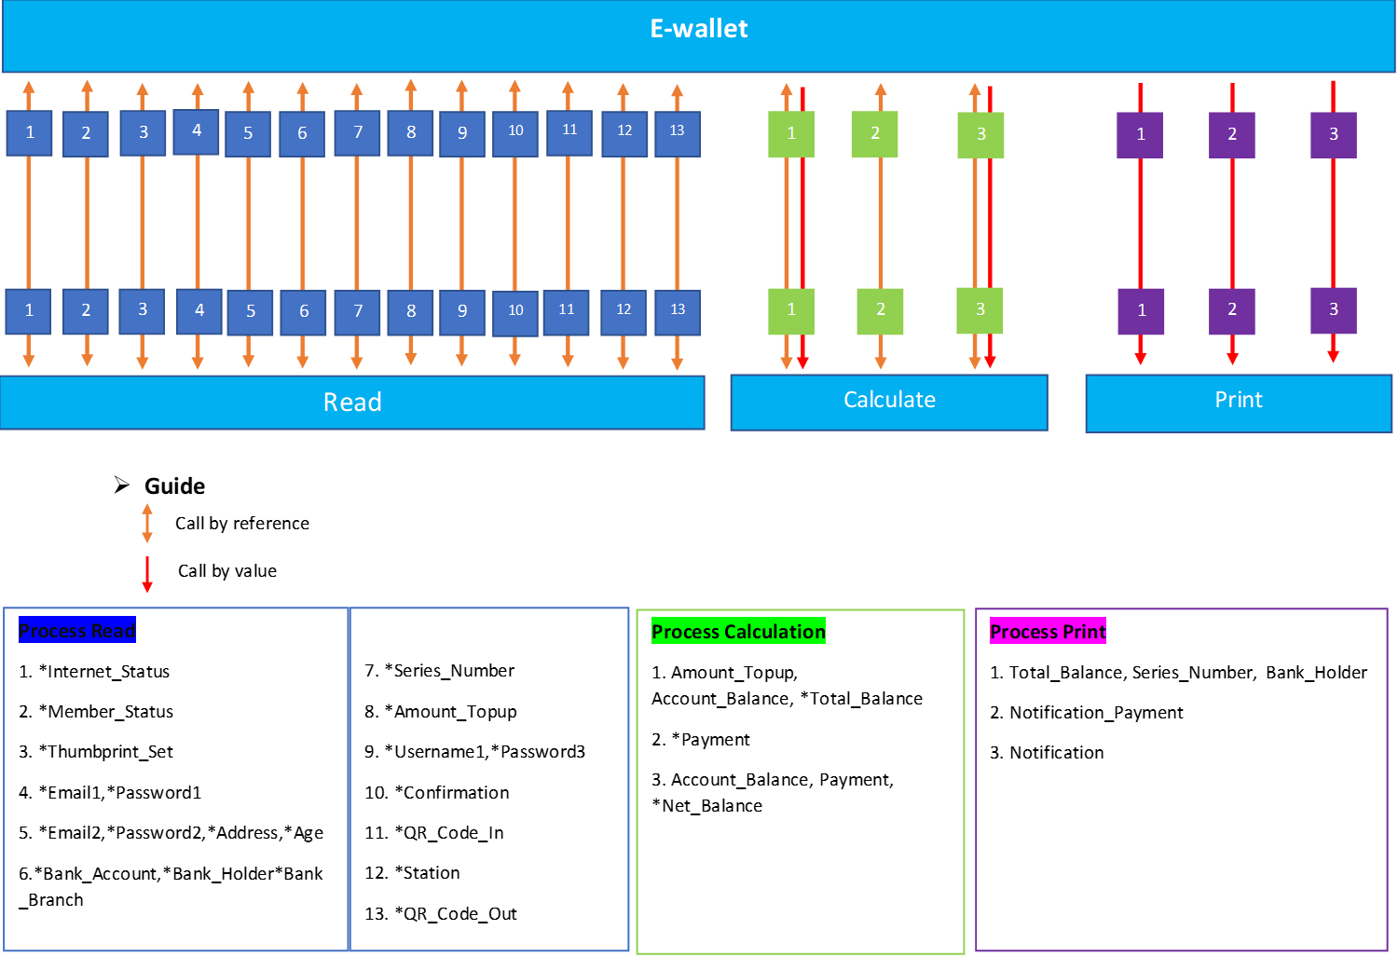
Coupling Diagram

Slide 31
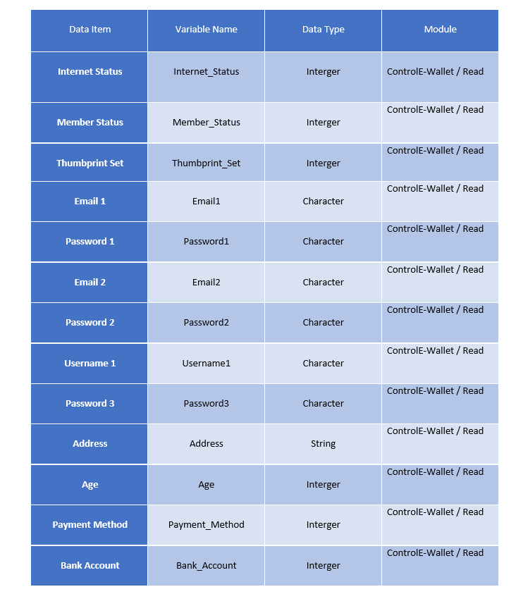
Data Dictionary

Slide 32
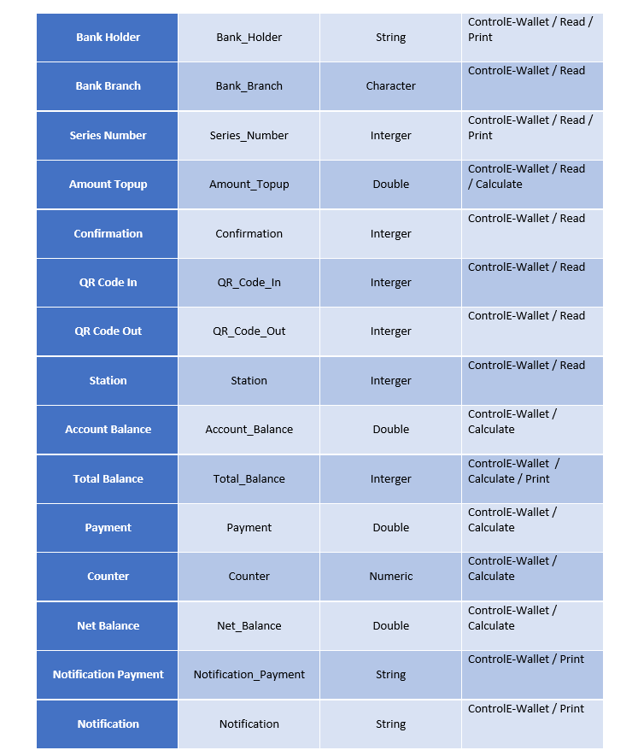
Data Dictionary

Slide 33
Algorithm – With Module

Slide 34
Algorithm – With Module

Slide 35
Algorithm – With Module

Slide 36
Algorithm – With Module

Slide 37
Algorithm – With Module

Slide 38
Algorithm – With Module

Slide 39
Algorithm – With Module

Slide 40
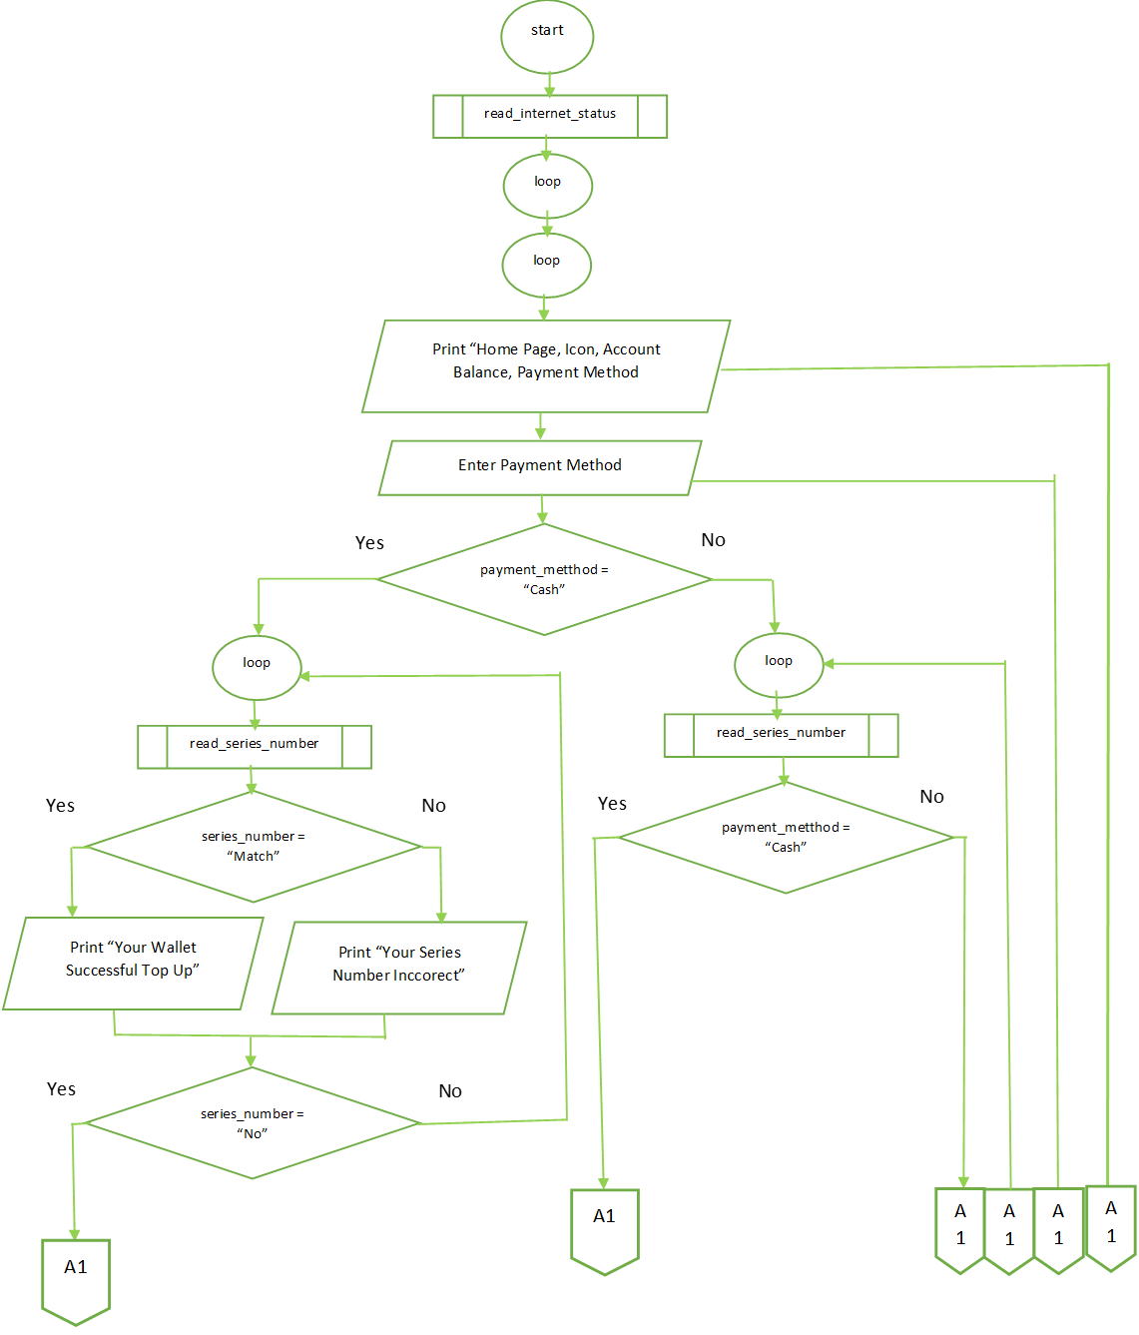
Flowchart – With Module

Slide 41
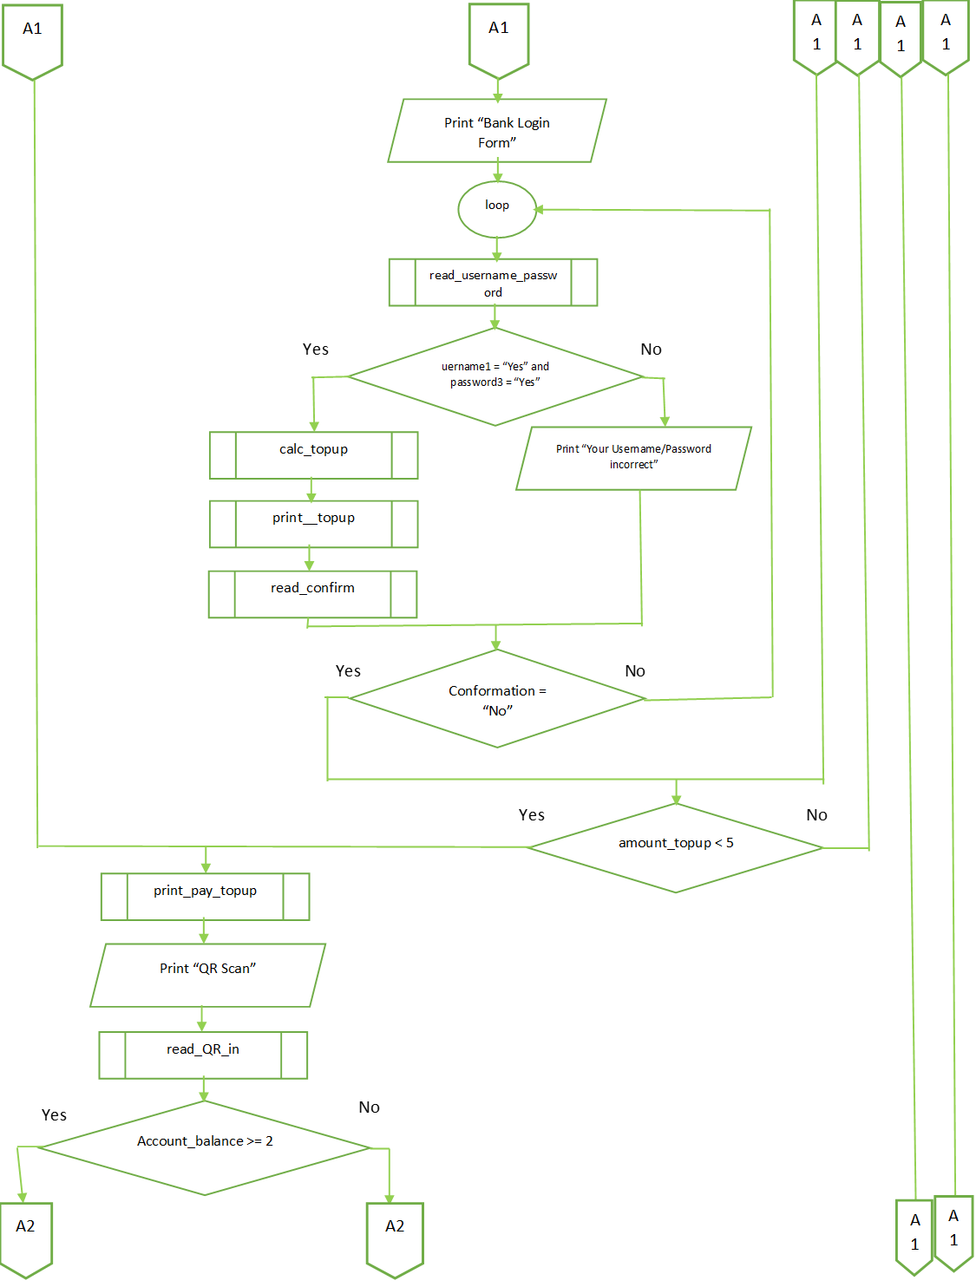
Flowchart – With Module

Slide 42
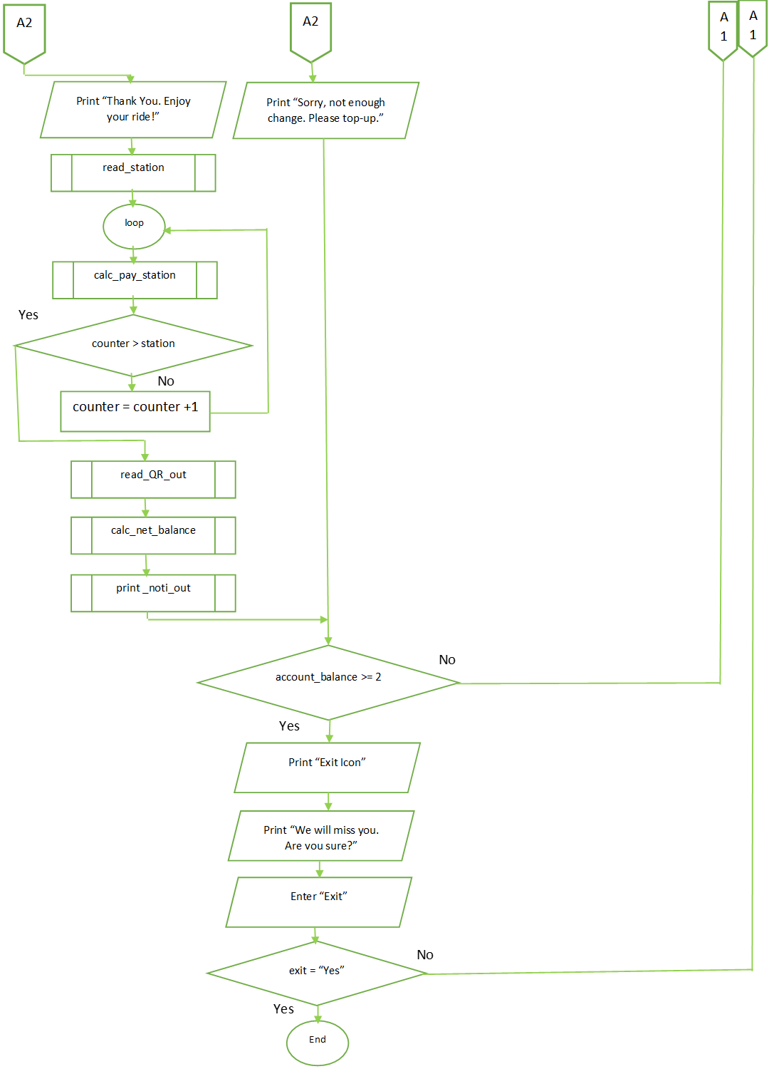
Flowchart – With Module

Slide 43
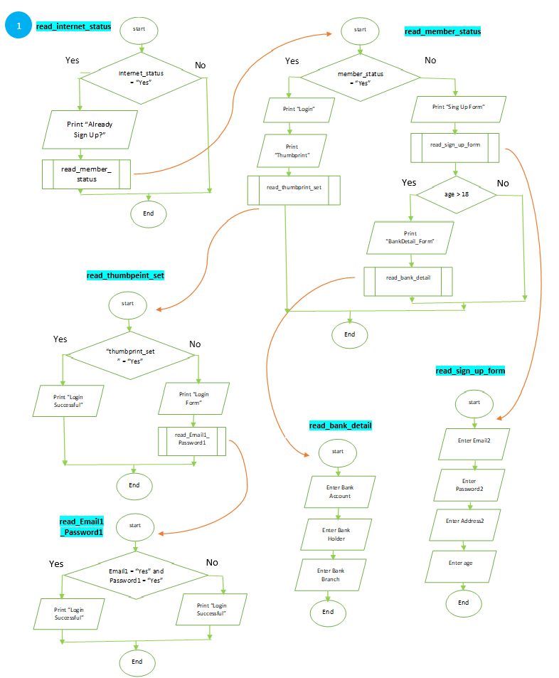
Flowchart – With Module

Slide 44
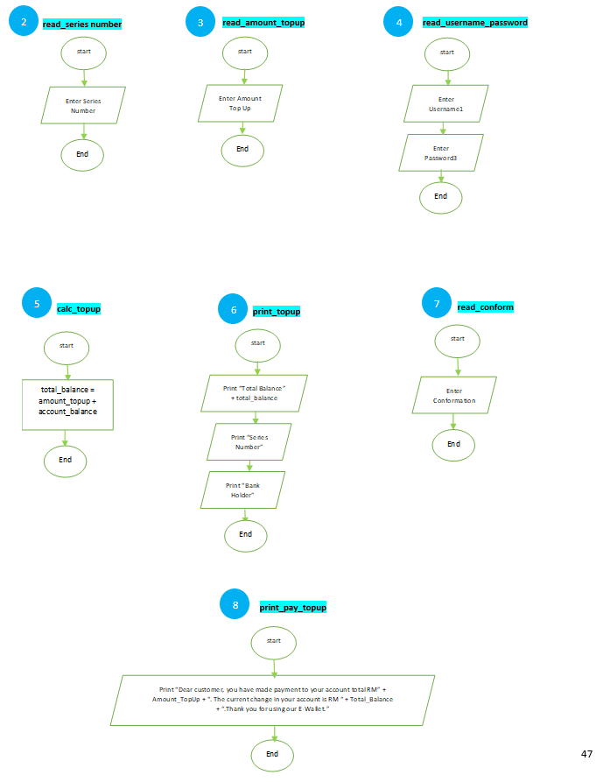
Flowchart – With Module

Slide 45
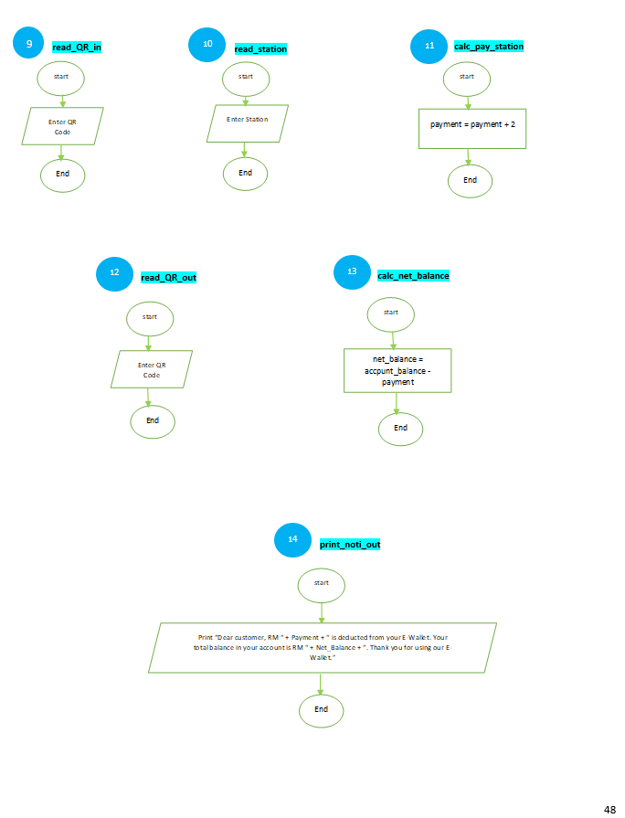
Flowchart – With Module

Slide 46
Flowchart – With Module

Slide 47
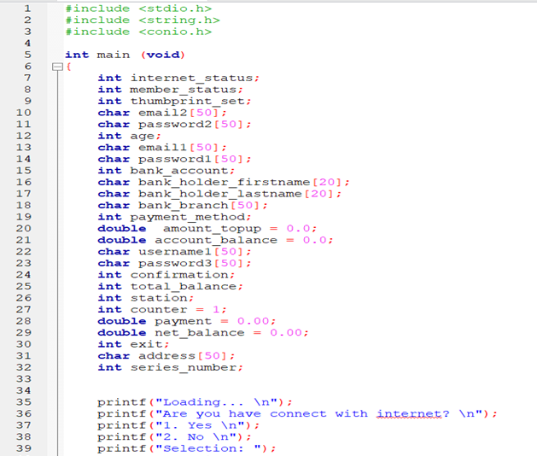
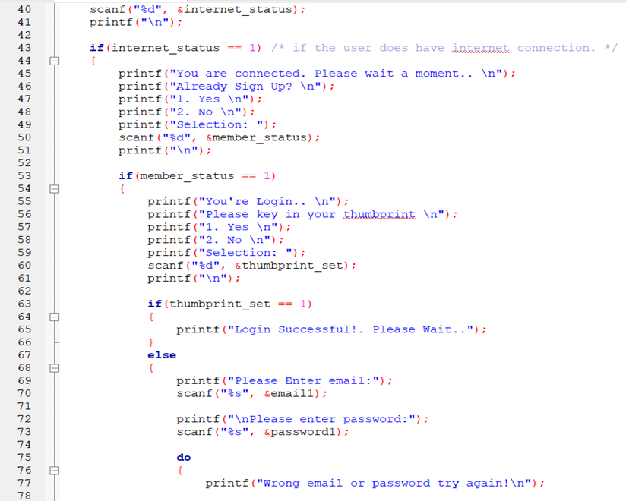
Programming

Slide 48
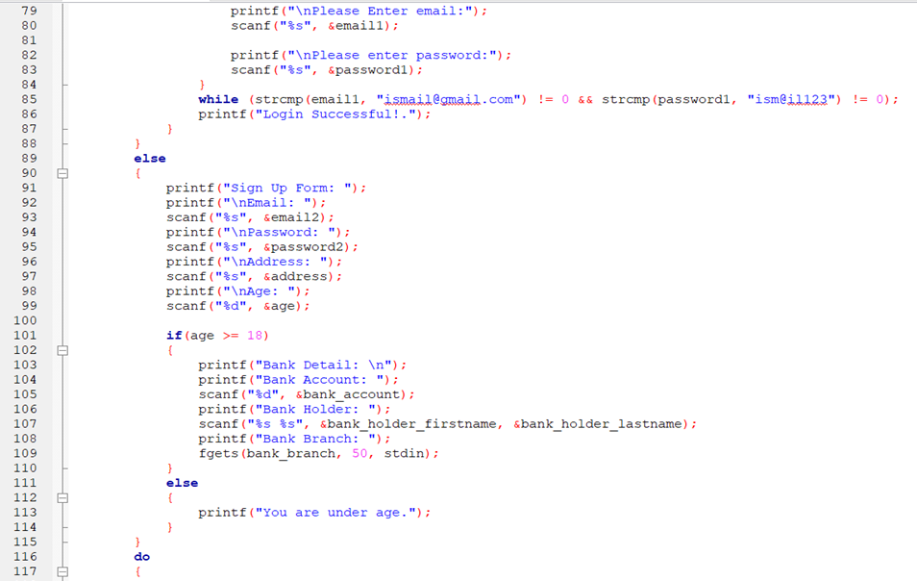
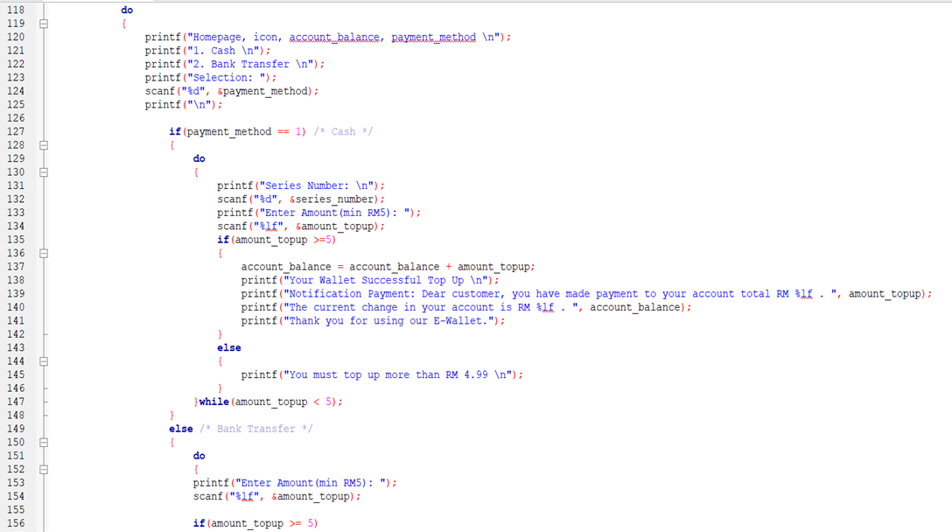
Programming

Slide 49
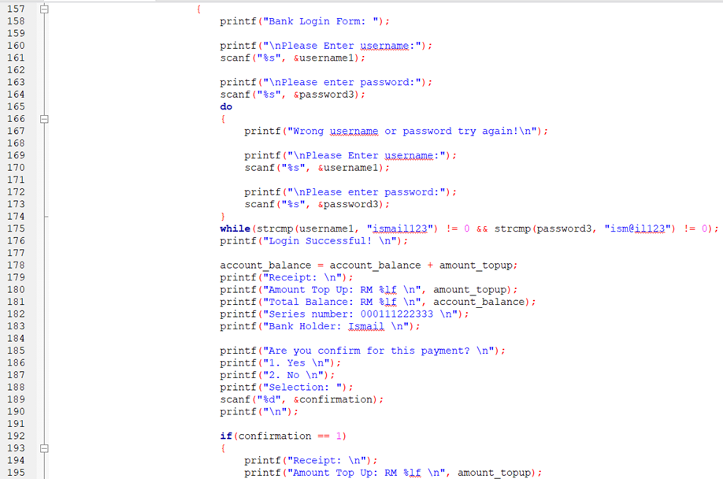
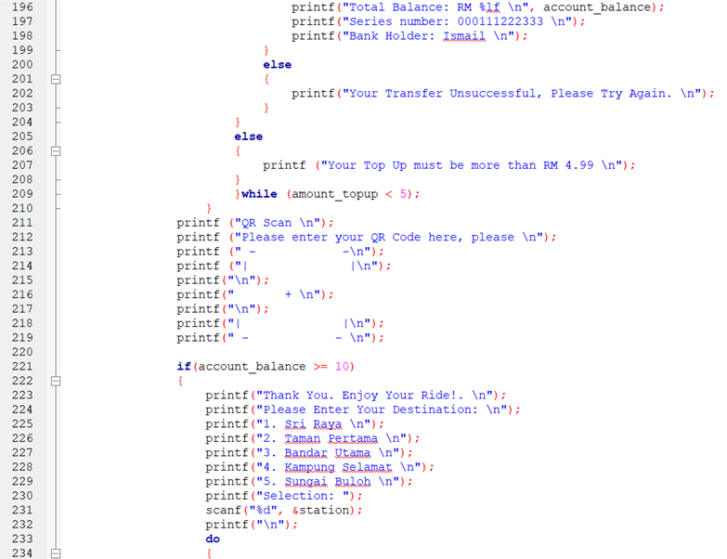
Programming

Slide 50
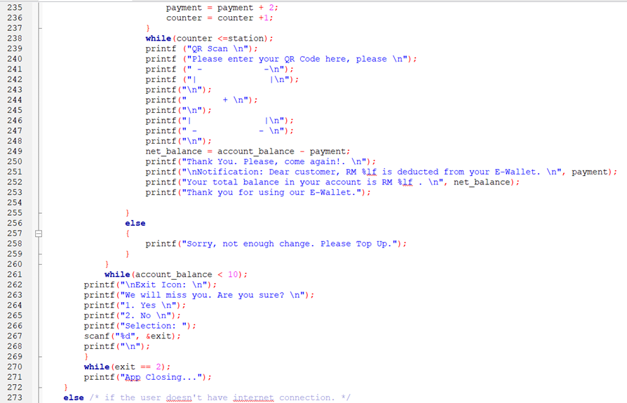

Programming

Slide 51
Prototype Interface

